Slide 1
Lesson 1: Windows Server 2012 Overview
On-Premises Servers
What Is Cloud Computing?
Windows Server 2012 Editions
What Is Server Core?
Windows Server 2012 Roles
What Are the Windows Server 2012 Features?
Notes:
20410B
1: Deploying and Managing Windows Server 2012

Slide 2
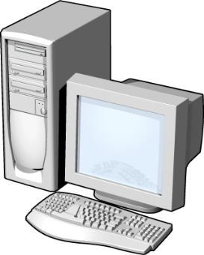
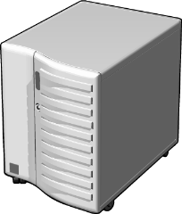
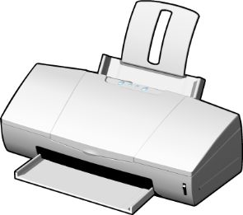


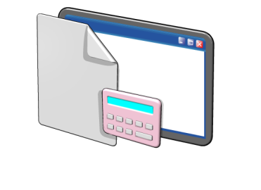
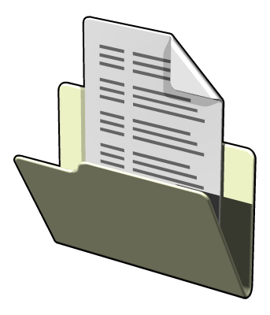

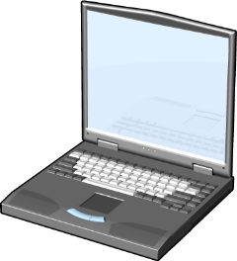

On-Premises Servers
Servers
Resources provided
to clients
Clients
Notes:
Discuss with students the need for locally deployed servers, and the role that they play now that organizations are moving some of their infrastructure to cloud computing.
Question
What is the difference between a server and a client operating system?
Answer
The difference between a server and a client operating system is that a server provides resources to many users on a network, and a client operating system is used by only one user at a time.
Question
How has the role of the server evolved over time from the Microsoft Windows NT 4.0 Server operating system to Windows Server 2012?
Answer
Answers will vary. Solicit class discussion about their experience with different versions of Windows Server.
20410B
1: Deploying and Managing Windows Server 2012

Slide 3



What Is Cloud Computing?
Types of cloud services:
IaaS
PaaS
SaaS
Public clouds have multiple tenants
Private clouds have a single tenant, which:
Is usually on-premises
Is highly automated
Uses System Center 2012 to provide automation and self-service
Requires minimal direct configuration once set up
Notes:
Ask students the extent to which they have adopted cloud services in their organizations.
If they have adopted cloud services in their organizations, ask how they have integrated cloud services into information technology infrastructure. If they have not, ask if and how they are planning to utilize cloud services in the future.
Question
Which type of cloud would you use to deploy a custom virtual machine running Windows Server 2012?
Answer
You would deploy a custom virtual machine to an IaaS cloud, which could be either a public cloud or a private cloud.
20410B
1: Deploying and Managing Windows Server 2012

Slide 4
Windows Server 2012 Editions
Windows Server 2012 editions:
Windows Server 2012 Standard operating system
Windows Server 2012 Datacenter operating system
Windows Server 2012 Foundation operating system
Windows Server 2012 Essentials operating system
Microsoft Hyper-V Server 2012
Windows Storage Server 2012 Workgroup operating system
Windows Storage Server 2012 Standard operating system
Windows MultiPoint Server 2012 Standard operating system
Windows MultiPoint Server 2012 Premium operating system
Notes:
Describe for students in what type of environment they would deploy each edition, and why they should not use the Windows Server 2012 Standard edition as a “one size fits all” solution.
20410B
1: Deploying and Managing Windows Server 2012

Slide 5
What Is Server Core?
Server Core
  Is a more secure, less resource-intensive installation option
  Can be converted to the full version of Windows Server 2012
  Is the default installation option for Windows Server 2012
  Is managed locally using sconfig.cmd
  If you enable remote management, you will rarely need to log on locally
Notes:
Inform students that they can run remote administration tools from client computers that are running appropriate editions of the Windows® 7 and Windows 8 operating systems.
20410B
1: Deploying and Managing Windows Server 2012

Slide 6
Windows Server 2012 Roles
Functions
  Web Server
  Domain Controller
  Certificate Server
Roles
  Are made up of role services components that provide additional functionality associated with the role
  In Server Manager 2012, console servers with a similar role are grouped together
  Role deployment also includes the configuration of dependencies
Notes:
Ask students about roles that are commonly deployed on their network. Ask which roles they deploy often, and which roles they are unlikely to deploy.
Question
Which roles are often co‑located on the same server?
Answer
Answers may vary. Domain Name System (DNS) and Active Directory® Domain Services (AD DS) are often co‑located.
20410B
1: Deploying and Managing Windows Server 2012

Slide 7
What Are the Windows Server 2012 Features?
Features:
  Are components that support the server such as Windows Server Backup or Failover clustering
  Usually do not provide a service directly to clients on the network
Keep in mind the following points:
  Roles can have features as dependencies
  Features on Demand are features that need to be installed using a mounted image as a source
Notes:
Choose several features to point out and discuss. For example, point out that you need to install the Wireless local area network (LAN) Service to use a wireless adapter with Windows Server 2012. Also point out that by default no roles and features are installed.
Question
Which feature do you need to install to support NetBIOS name resolution for client computers running a Microsoft Windows NT® 4.0 operating system workstation?
Answer
You need to install the Windows Internet Name Service (WINS) server role to support NetBIOS name resolution.
20410B
1: Deploying and Managing Windows Server 2012

Slide 8
Lesson 2: Overview of Windows Server 2012 Management
What Is Server Manager?
Administrative Tools and Remote Server Administration Tools
Configuring Services
Configuring Windows Remote Management
Notes:
Briefly present the lesson content.
20410B
1: Deploying and Managing Windows Server 2012

Slide 9

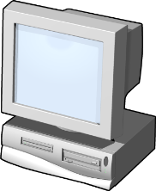
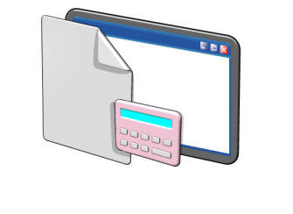

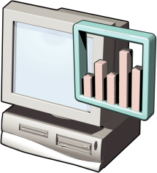

What Is Server Manager?
You can use Server Manager to:
Manage multiple servers on a network from one console
Add roles and features
Launch Windows PowerShell sessions
View events
Perform server configuration tasks
Notes:
Demonstrate different Server Manager windows to illustrate the bulleted points on the slide.
20410B
1: Deploying and Managing Windows Server 2012

Slide 10
Administrative Tools and Remote Server
Administration Tools
Administrative tools:
  Active Directory Administrative Center
  Active Directory Users and Computers
  DNS console
  Event Viewer
  Group Policy Management Console
  IIS Manager
  Performance Monitor
  Resource Monitor
  Task Scheduler
Notes:
Describe each administrative tool and its function.
20410B
1: Deploying and Managing Windows Server 2012

Slide 11
Configuring Windows Remote Management
When deciding to use Remote Management, consider the following:
  You are more likely to manage a server remotely than by locally logging on
  With WinRM, you can use consoles, command-line utilities, or Windows PowerShell to perform remote management tasks
  With Remote Desktop, you can log on to a server locally or from across the network
Notes:
Ask students how often they perform server management when they are signed in locally using a keyboard and mouse, compared to how often they perform remote server management.
Ask students which management technologies they use most frequently. Ask them what the benefits and drawbacks are of these technologies.
20410B
1: Deploying and Managing Windows Server 2012

Slide 12
Lesson 3: Installing Windows Server 2012
Installation Methods
Installation Types
Hardware Requirements for Windows Server 2012
Installing Windows Server 2012
Notes:
20410B
1: Deploying and Managing Windows Server 2012

Slide 13
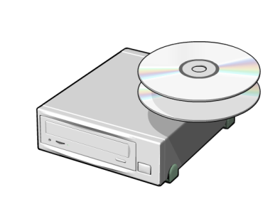

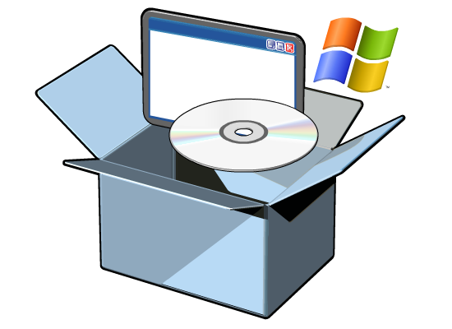
Installation Methods
Windows Server 2012 deployment method
options include:
Optical disk
USB media
Windows DS
Notes:
Ask students which deployment method they most frequently use in their organization. Answer is likely to differ between clients and servers. Ask them if they have already deployed Windows Server 2012, and if so, what method they used for this deployment.
Question
What is another method that you can use to deploy Windows Server 2012?
Answer
You can also configure Windows Server 2012 to boot to either a .vhd or a .vhdx file. Deployment involves copying the .vhd file to a computer, either from a network share or from local media.
20410B
1: Deploying and Managing Windows Server 2012

Slide 14
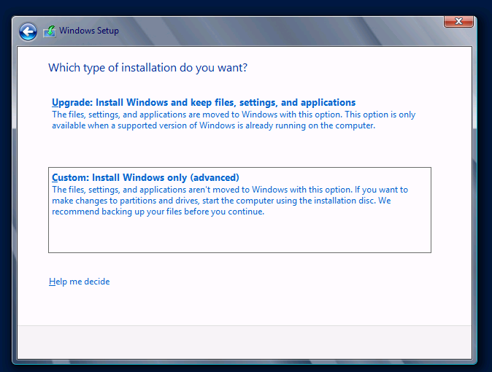
Installation Types
Notes:
20410B
1: Deploying and Managing Windows Server 2012

Slide 15

Hardware Requirements for Windows
Server 2012
Windows Server 2012 has the following minimum hardware requirements:
  Processor architecture x86-64
  Processor speed 1.4 GHz
  Memory (RAM) 512 MB
  Hard disk drive space 32 GB
    More hard disk drive space
    is needed if the server has
    more than 16 GB of RAM
Notes:
Remind students that the minimum hardware requirements are for the operating system itself, and do not include any applications that they might want to deploy on the operating system. Hardware requirements also vary depending on the server role. For example, a SQL Server database server requires a more powerful processor and more RAM than a server that functions as a file server.
Question
Why does a server need more hard disk drive space if it has more than 16 GB of RAM?
Answer
A server needs more hard disk drive space because it requires additional hard disk space for virtual memory.
20410B
1: Deploying and Managing Windows Server 2012

Slide 16

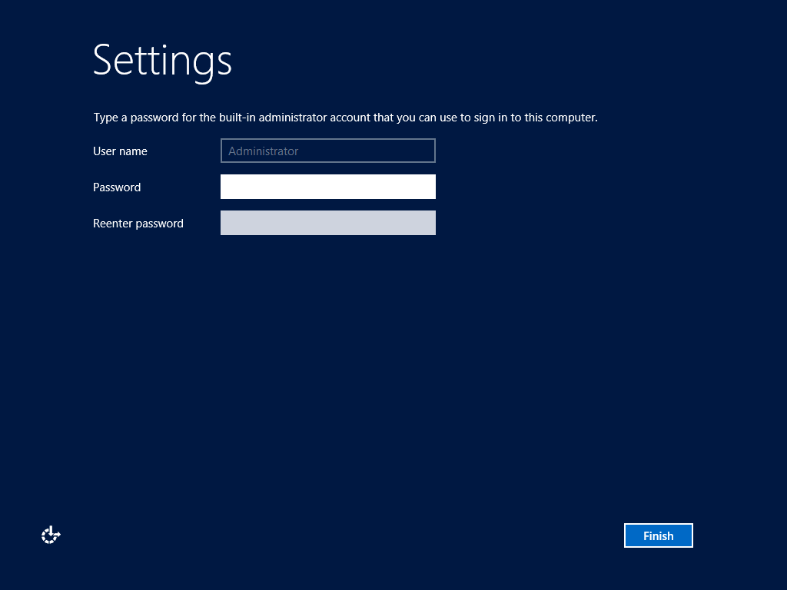
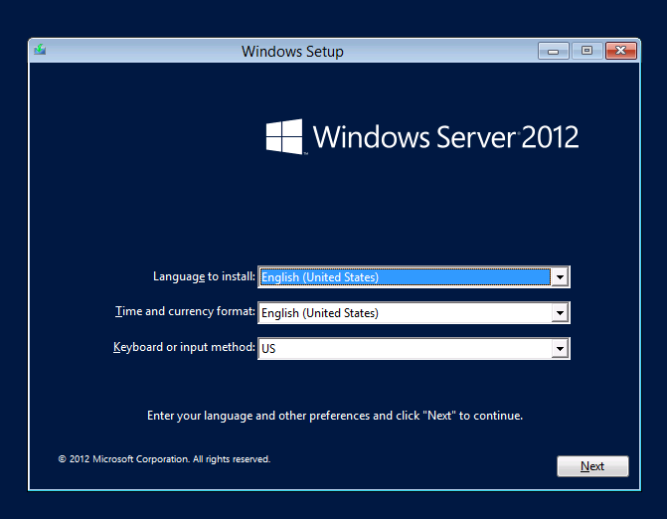
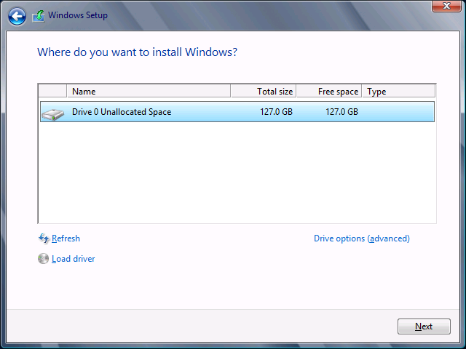
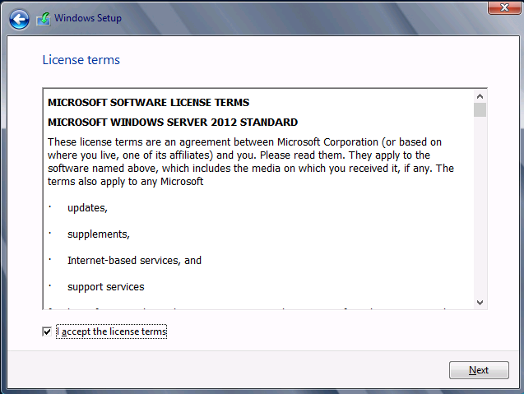
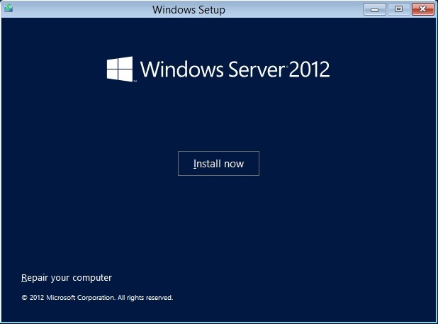
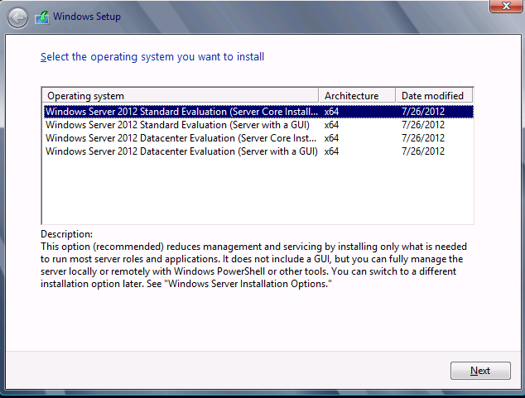
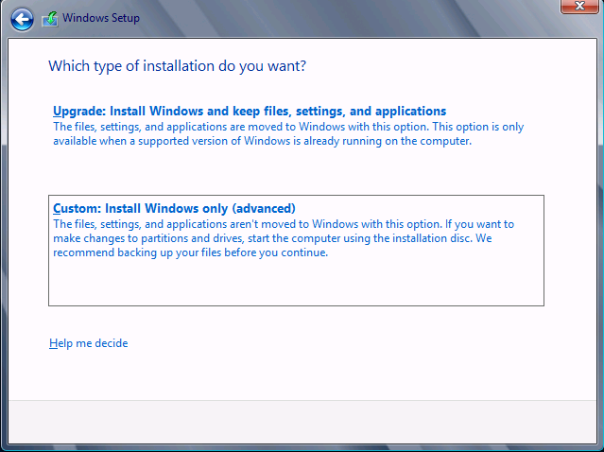
Installing Windows Server 2012
Notes:
This is an animated build slide with seven screens. The first screen is present at slide load. Click six times to see the remaining six screens. The screens are:
Screen 1 (present at slide load): Choose installation language, currency format, time format, and keyboard input method.
Screen 2: Click Install Now or choose to repair your computer.
Screen 3: Select the operating system you want to install.
Screen 4: Review and accept the license terms.
Screen 5: Select the installation type, Upgrade or Custom.
Screen 6: Select the installation location.
Screen 7: Provide the password for the local administrator account.
Use this animated slide to demonstrate each part of the Windows Server 2012 installation process.
Reinforce that only a small number of choices are required to deploy Windows Server 2012.
Remind students that in almost all cases, they will use the Custom rather than the Upgrade installation option.
Remind them that upgrades must be launched from within the Windows Server operating system, but that they can launch a fresh installation from bootable media.
20410B
1: Deploying and Managing Windows Server 2012

Slide 17
Lesson 4: Post-Installation Configuration of Windows Server 2012
Overview of Post-Installation Configuration
Configuring Server Network Settings
How to Join a Domain
Performing an Offline Domain Join
Activating Windows Server 2012
Configuring a Server Core Installation
Notes:
20410B
1: Deploying and Managing Windows Server 2012

Slide 18
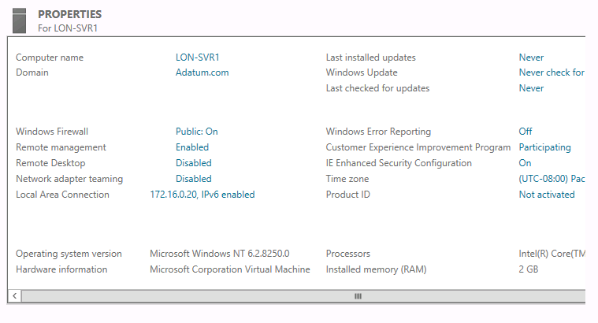
Overview of Post-Installation Configuration
Notes:
Use this animated slide to discuss the properties outlined on the slide.
Click once for each of the following properties (seven times total), which appear in this order:
Computer name
Domain
Windows Firewall
Remote Desktop
Local Area Connection
(all three together) Last installed updates, Windows Update, Last checked for updates
Time zone
20410B
1: Deploying and Managing Windows Server 2012

Slide 19
Configuring Server Network Settings
Notes:
Refer to slide that shows a screen capture of the local server node for the Server Manager console. In the local server node, the Local Area Connection and IP address display. Also note that the Network adapter teaming status displays.
20410B
1: Deploying and Managing Windows Server 2012

Slide 20
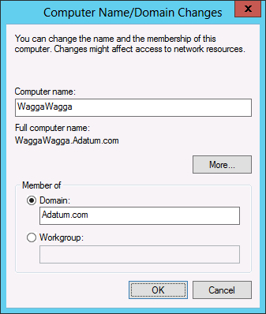
How to Join a Domain
Information necessary for a domain join:
Domain name
Account with permission to join computer to domain
Notes:
Display the Computer Name/Domain Changes dialog box, and review the list of information necessary for domain join.
20410B
1: Deploying and Managing Windows Server 2012

Slide 21




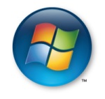
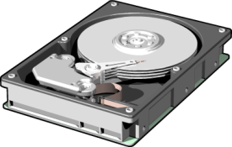


Performing an Offline Domain Join
Process for performing an offline join:
Ensure the user performing the offline domain join is an administrator, or delegate the appropriate rights
To provision the computer account object and create the binary file, run djoin on the domain controller
Transfer the binary file with the domain information to client computer system’s hard disk drive
To load the binary file, in the destination computer, run djoin
Restart the client computer
Windows Server 2012
Notes:
Discuss the scenarios for offline domain join. Ask students how they might utilize this feature in their own environments. Students from organizations that do not have branch offices will find this feature less useful than students from organizations that have remote branches.
Question
In what situation would you perform an offline domain join rather than a traditional domain join?
Answer
You would you perform an offline domain join when deploying a server to a remote site with intermittent network connectivity.
20410B
1: Deploying and Managing Windows Server 2012

Slide 22
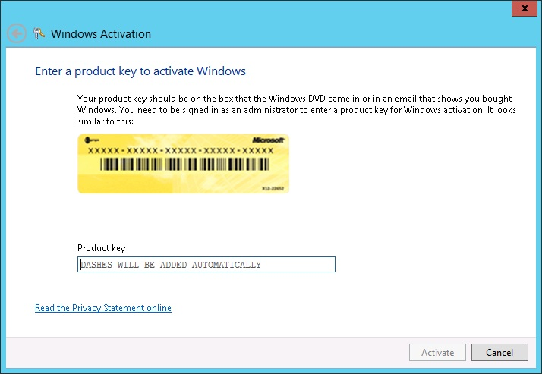
Activating Windows Server 2012
Notes:
Discuss the traditional activation process. Ask students about the last time they performed a telephone activation. Ask students if they have ever had any problems with activation, and how they resolved the problem. Ask students if they use any automatic activation technologies in their environment.
20410B
1: Deploying and Managing Windows Server 2012

Slide 23
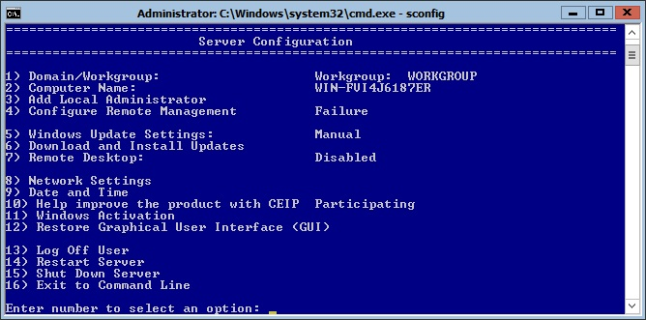
Configuring a Server Core Installation
Notes:
Discuss with students the functionality of sconfig.cmd.
Sconfig is a menu‑driven command‑line tool that presents menu options in a numerical format. Administrators can run commands and perform configurations based on the numbered menu options
This tool simplifies the process of performing common basic administrative tasks on Server Core, something that was a problem for many administrators with the version of Server Core that was available with Windows Server 2008.
20410B
1: Deploying and Managing Windows Server 2012

Slide 24
Lesson 5: Introduction to Windows PowerShell
What Is Windows PowerShell?
Windows PowerShell Cmdlet Syntax
Common Cmdlets for Server Administration
What Is Windows PowerShell ISE?
Demonstration: Using Windows PowerShell
Demonstration: Using Windows PowerShell ISE
Notes:
20410B
1: Deploying and Managing Windows Server 2012

Slide 25
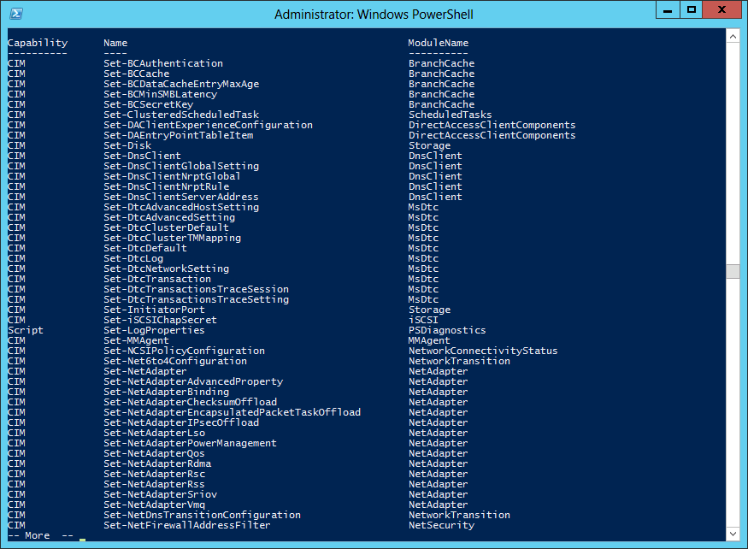
What Is Windows PowerShell?
Notes:
A cmdlet or "Command let" is a lightweight command used in the Windows PowerShell environment.
The Windows PowerShell runtime invokes these cmdlets at command prompt.
Windows PowerShell is a command-line shell and scripting language designed especially for system administration. Its analogue in Linux is called as Bash Scripting. Built on the .NET Framework, Windows PowerShell helps IT professionals to control and automate the administration of the Windows operating system and applications that run on Windows Server environment.
Windows PowerShell commands, called cmdlets, let you manage the computers from the command line. Windows PowerShell providers let you access data stores, such as the Registry and Certificate Store, as easily as you access the file system.
In addition, Windows PowerShell has a rich expression parser and a fully developed scripting language. So in simple words you can complete all the tasks that you do with GUI and much more.
20410B
1: Deploying and Managing Windows Server 2012

Slide 26
Windows PowerShell Cmdlet Syntax
Windows PowerShell Cmdlet Syntax:
Get-Help -Noun NounName/Verb VerbName
Help CmdltName
Get-Command
Notes:
When discussing Windows PowerShell, remind students that they should consider automating repetitive tasks because it gives them more time to perform non‑repetitive tasks. Students should try to automate any task that they need to perform more than a few times.
Getting Help
The first step is to go to the Get-Help command which gives you an explanation about how to give a command and its parameter.
20410B
1: Deploying and Managing Windows Server 2012

Slide 27
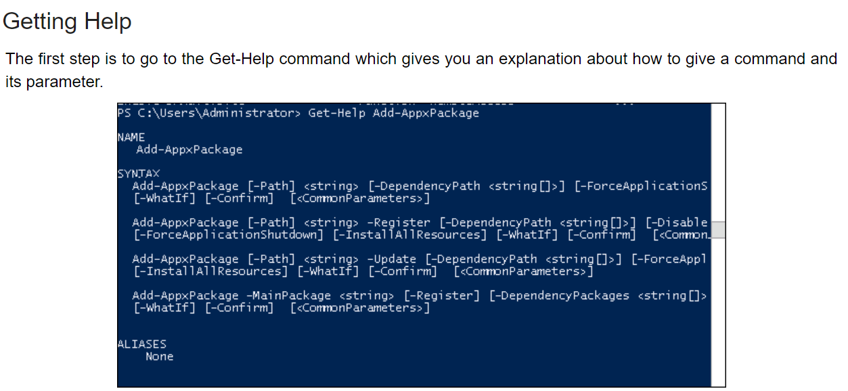

Slide 28
Common Cmdlets for Server Administration
Service Cmdlets
  Use the Service noun
Event Log Cmdlets
  Use the Eventlog noun
Process Cmdlets
  Use the Process noun
ServerManager module
  Allows the WindowsFeature noun
Notes:
Discuss these common systems administration cmdlets. Discuss how these cmdlets can be used on both Server Core and full GUI servers, and that they are often quicker to use than opening the Services console, Task Manager, or the Add Roles and Features wizard.
20410B
1: Deploying and Managing Windows Server 2012

